Slide 1
GLOBAL POWER PLATFORM BOOTCAMP 2023 PL

Slide 2
GLOBAL POWER PLATFORM BOOTCAMP 2023 PL

Slide 4
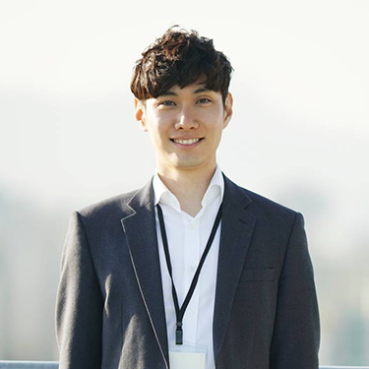
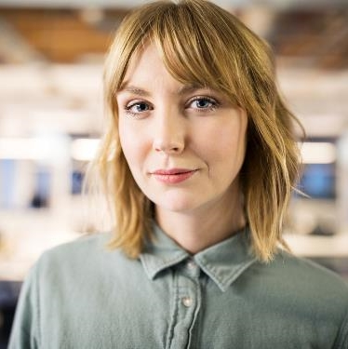

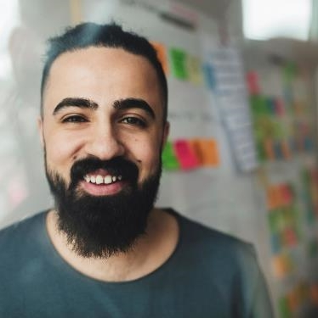
Speakers
Takuma Hayashi
Mirjam Nilsson
Flora Berggren
Rajesh Santoshi
President
Chief Executive Officer
Chief Operations Officer
VP Marketing
4

Slide 5
Agenda

Slide 6
PROBLEM
MARKET GAP
COSTS
Few, if any, products on the market help customers like we do
Loss of productivity costing consumers thousands of dollars
CUSTOMERS
USABILITY
66% of US consumers spend money on multiple products that only partially resolves their issue
Customers want something easy to use that helps make their life easier
FINANCIALS
Millennials account for about a quarter of the $48 billion spent on other products in 2018
6

Slide 7
PRODUCT OVERVIEW
UNIQUE
TESTED
Only product specifically dedicated to this niche market
Conducted testing with college students in the area
FIRST TO MARKET
AUTHENTIC
First beautifully designed product that's both stylish and functional
Designed with the help and input of experts in the field
7

Slide 8
PRODUCT BENEFITS
Cool and stylish product
Areas for community connections
Online store and market swap
8

Slide 9
Demo Title
9

Slide 10



BUSINESS MODEL
RESEARCH
ABSTRACT
DESIGN
We based our research on market trends and social media
We believe people need more products specifically dedicated to this niche market
Minimalist and easy to use
10

Slide 11
MARKET OVERVIEW
$3B
$2B
$1B
Opportunity to build
Fully inclusive market
Total addressable market
Freedom to invent
Selectively inclusive market
Serviceable available market
Few competitors
Specifically targeted market
Serviceable obtainable market
11

Slide 12
MARKET COMPARISON
$3B
Opportunity to build + addressable market
$2B
Freedom to invent + serviceable market
$1B
Few competitors + obtainable market
12

Slide 13
Demo Title
13

Slide 14
OUR COMPETITION
CONTOSO
COMPETITORS
Our product is priced below that of other companies on the market
Design is simple and easy to use, compared to the complex designs of the competitors
Affordability is the main draw for our consumers to our product
Company A Product is more expensive
Companies B & C Product is expensive and inconvenient to use
Companies D & E Product is affordable, but inconvenient to use
14

Slide 15
OUR COMPETITION GRAPHIC
CONTOSO
A
CONVENIENT
EXPENSIVE
AFFORDABLE
D
C
E
INCONVENIENT
B
15

Slide 16
GROWTH STRATEGY
How we’ll scale in the future
PHASE 1: FEB 20XX
Roll out product to high profile or top-level participants to help establish the product
PHASE 2: MAY 20XX
Release of the product to the general public and monitor press release and social media accounts
PHASE 3: OCT 20XX
Gather feedback and adjust product design as necessary
16

Slide 17
TRACTION
Forecasting for success
KEY METRICS
REVENUE BY YEAR
 | Clients | Orders | Gross revenue | Net revenue
20XX | 10 | 1100 | $10,000 | $7,000
20XX | 20 | 200 | $20,000 | $16,000
20XX | 30 | 300 | $30,000 | $25,000
20XX | 40 | 400 | $40,000 | $30,000
17

Slide 18
FINANCIALS
 | Year 1 | Year 2 | Year 3
INCOME
Users | 50,000 | 400,000 | 1,600,000
Sales | 500,000 | 4,000,000 | 16,000,000
Average price per sale | 75 | 80 | 90
Revenue @ 15% | 5,625,000 | 48,000,000 | 216,000,000
Gross profit | 5,625,000 | 48,000,000 | 216,000,000
EXPENSES
Sales & marketing | 5,062,500 | 38,400,000 | 151,200,000 | 70%
Customer service | 1,687,500 | 9,600,000 | 21,600,000 | 10%
Product development | 562,500 | 2,400,000 | 10,800,000 | 5%
Research | 281,250 | 2,400,000 | 4,320,000 | 2%
Total expenses | 7,593,750 | 52,800,000 | 187,920,000
18

Slide 19



FUNDING
$12,000
$14,000
Property
Angel Investments
Revenue obtained from property rentals
Amount obtained through other investors
$32,000
Cash
19

Slide 20
Any Questions?

Slide 21
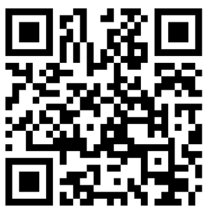
QUIZ!
The winner gets a 2-day pass to the European Power Platform Conference
21-22 June in Dublin
https://forms.office.com/r/6Zm4XNEe5t

Slide 22
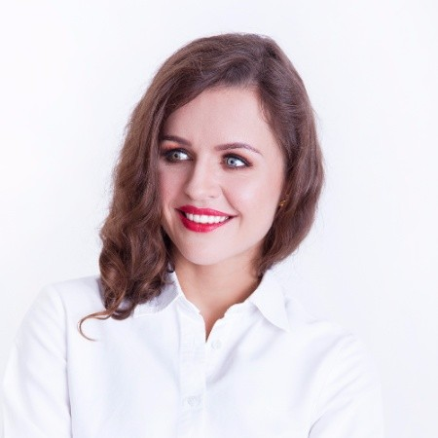
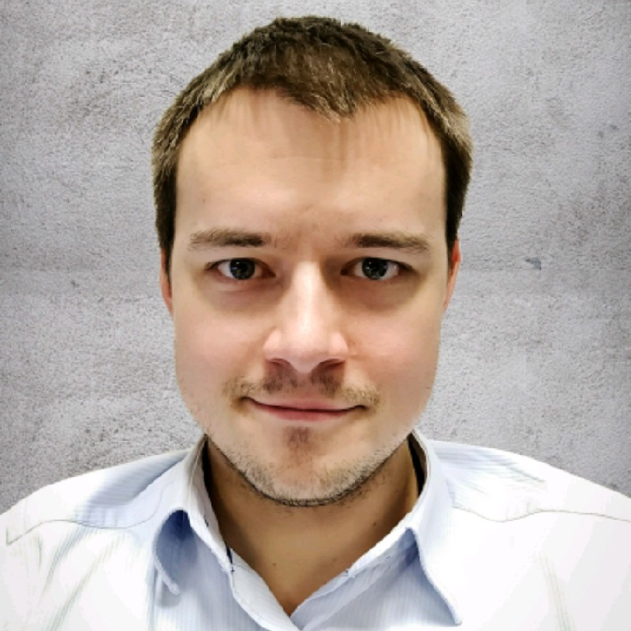
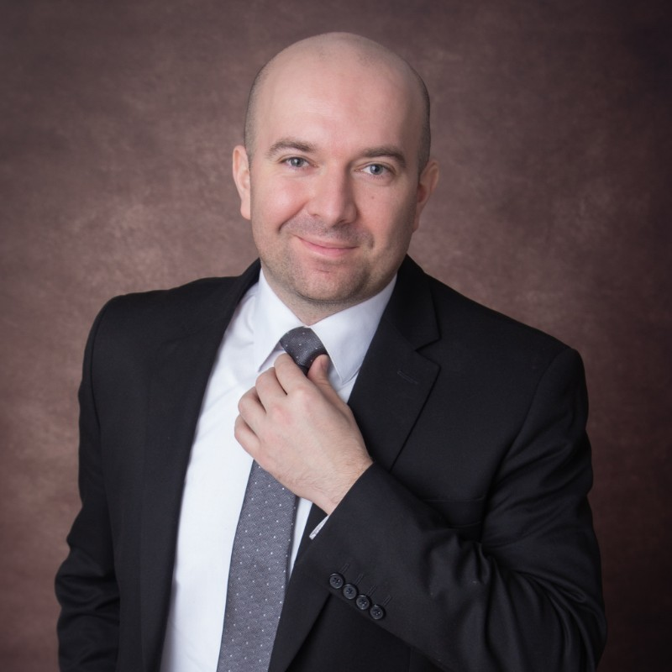
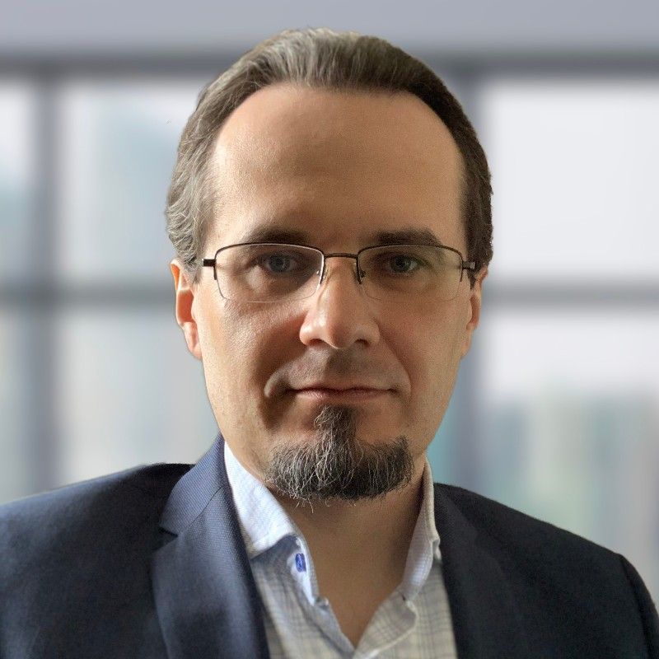
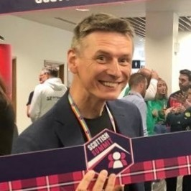
GLOBAL POWER PLATFORM BOOTCAMP 2023 PL Event Brought to you by COMMUNITY MEMBERS
Edyta Gorzoń
Tomasz Poszytek
Dawid Ziółkowski
Marcin Siewnicki
Michał Ziemba
Microsoft MVP | Product Manager - Microsoft Channels at Staffbase
Power Platform Advisor | Speaker | Microsoft MVP | MCT
Microsoft Business Applications MVP, Office 365 and Power Platform expert
Office 365 Consultant/Architect at ISCG Sp. z o.o.
MCT, Solution Architect & IT Systems Integrator
22

Slide 23

Event Sponsors

Slide 24
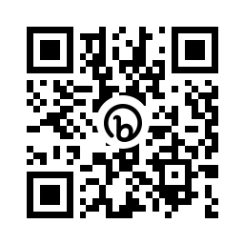
Please fill out the survey! & Win Swags!!
https://bit.ly/GPPBSurvey

Slide 25
Thank you
Resources:
25

